Slide 1

My Linear Relationships Interactive Notebook
Name:
Class:
Teacher:
Semester 2
Term 3
1

Slide 2

Interactive Notebooks!
Cover Page
Contents Page
Glossary
24/7/30
EQ
Questions
Notes
Summaries
Work page
Presentation!!!
Your book, your responsibility!

Slide 3

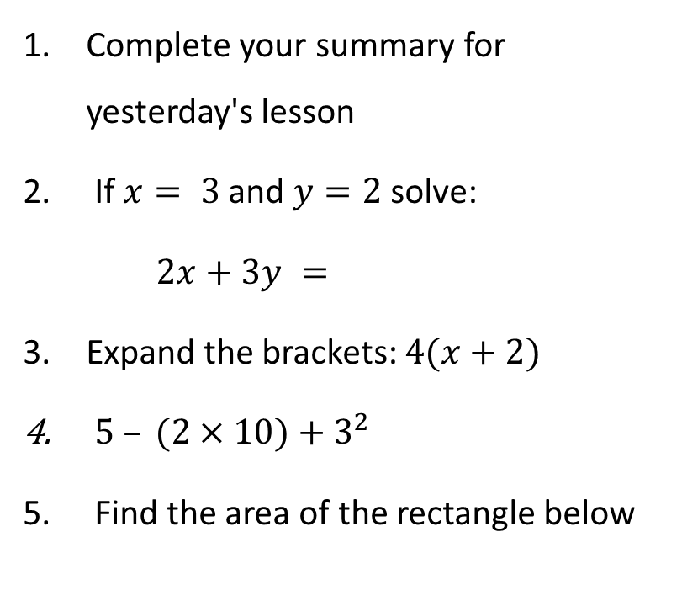
5 Questions
Complete your summary for yesterday's lesson
If $x= 3$and $y=2$ solve:
$2x+3y =$
Expand the brackets: $4(x+2)$
$5 – (2×10)+3^{2}$
Find the area of the rectangle below
First 10 to finish get VIVOs
Let’s go!
12 m
7 m

Slide 4

Quickwrite
What do you know about plotting points on a graph.
You have 2 minutes to write all you can remember
Notes:
Give them time to write what they know on the left hand side.
How you get the info off them is up to you, TPS, popcorn etc.

Slide 5
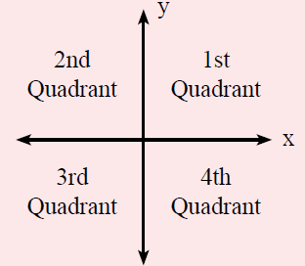
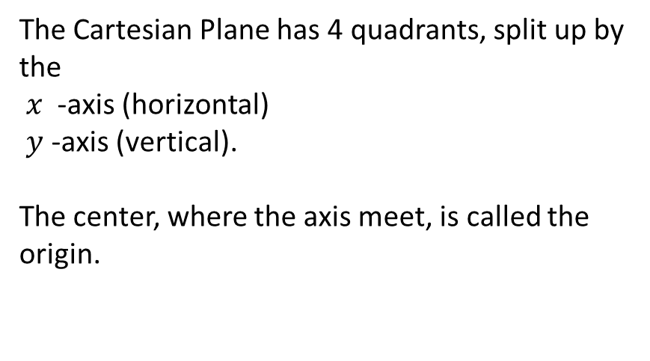

24
7
30
Topic: Linear Relationships
Date
EQ – How do I plot points on a Cartesian Plane?
What is the Cartesian Plane?
The Cartesian Plane has 4 quadrants, split up by the
$x$ -axis (horizontal)
$y$ -axis (vertical).
The center, where the axis meet, is called the origin.
$$Coordinates are \left(x ,y\right)$$

Slide 6
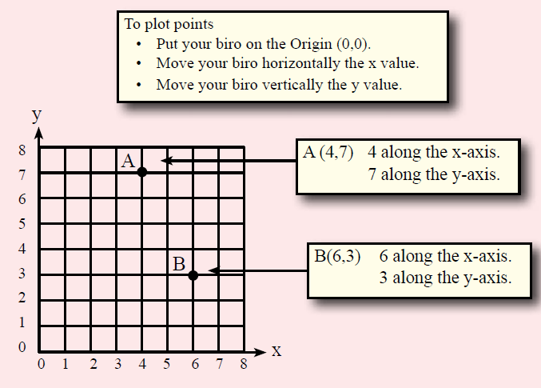
24
7
30
Topic: Linear Relationships
Date
EQ – How do I plot points on a Cartesian Plane?
How do you plot points on a Cartesian Plane?

Slide 7
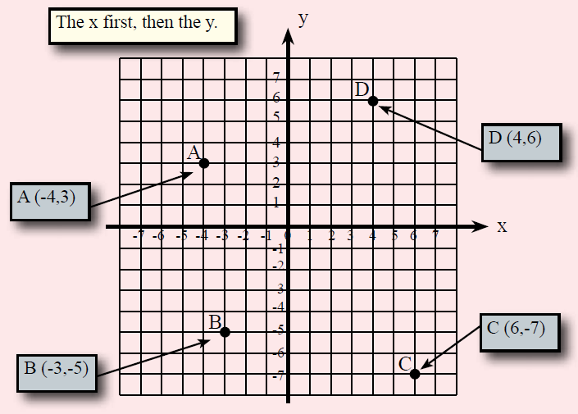
24
7
30
Topic: Linear Relationships
Date
EQ – How do I plot points on a Cartesian Plane?
How do you plot points on a Cartesian Plane?

Slide 8
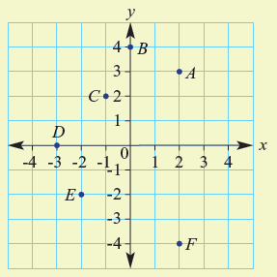

Let’s try one together
Write down the coordinates for A-F

Slide 9
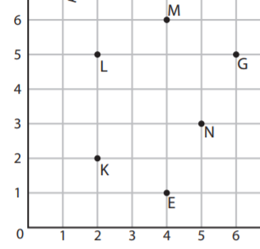
Your turn

Slide 10

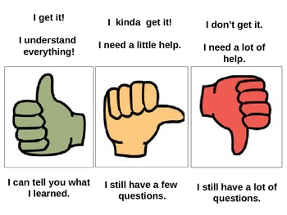
Do you understand?
Notes:
Check for Understanding

Slide 11

Your Turn
WORKSHEETS
Left Hand Side
Notes:
Use worksheets available on connect

